Slide 1

Session 12: Finance Skills
Lillian with
baby Carolyn
Susan
Finance Quiz
Finance Exercise
Assessing financial capacity

Slide 2
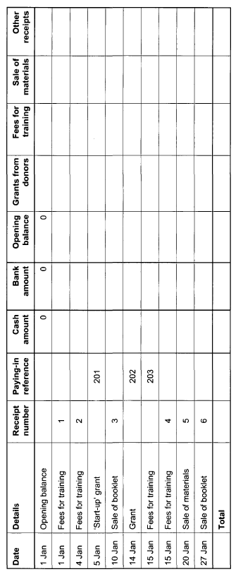
Lillian with
baby Carolyn
Susan

Slide 3
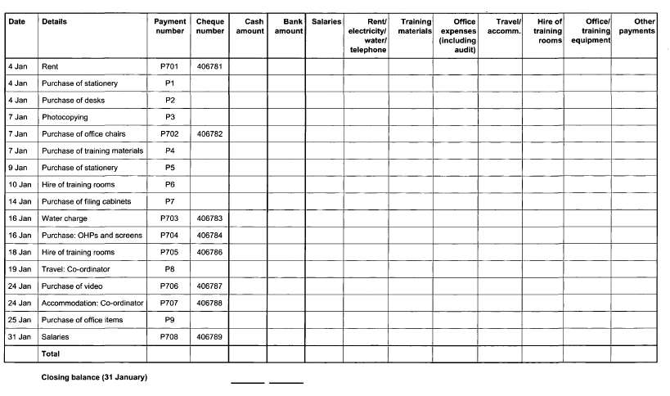
Lillian with
baby Carolyn
Susan

Slide 4
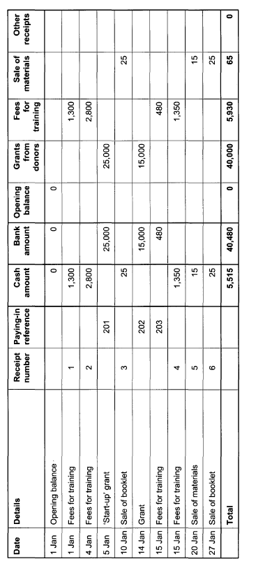
Lillian with
baby Carolyn
Susan

Slide 5
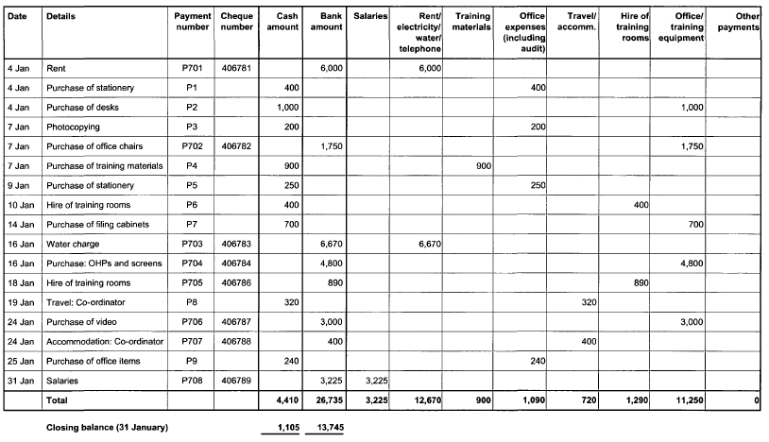
Lillian with
baby Carolyn
Susan

Slide 6
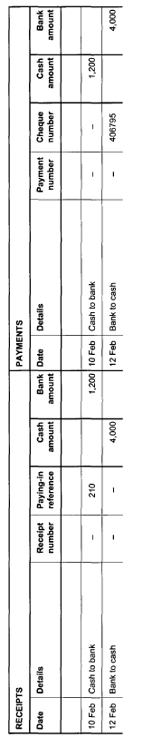
Lillian with
baby Carolyn
Susan

